Slide 1
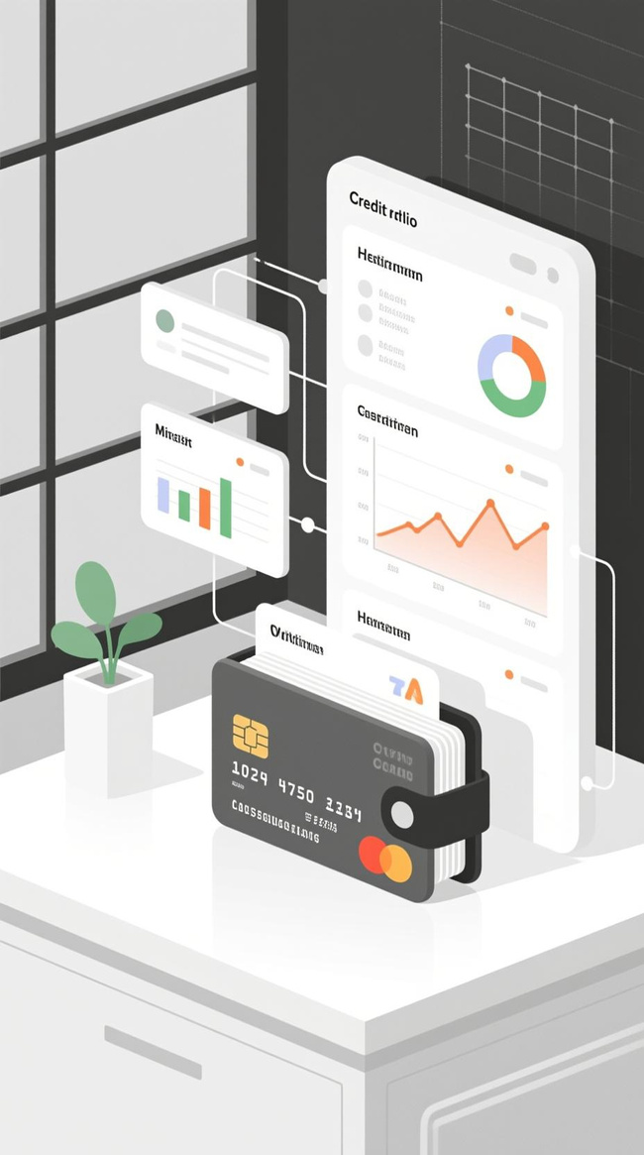


Problem Statement:
EARLY RISK SIGNALS -
CREDIT CARD DELINQUENCY WATCH
Presenter: Rohit Sah
Roll No: GA.10

Slide 2


THE PROBLEM
MOVING BEYOND LAG INDICATORS
Current State: Banks rely on late signals like missed payments or 30+ DPD (Days Past Due).
The Gap: By the time a payment is missed, financial stress has already occurred.
The Challenge: Identifying subtle behavioral changes before delinquency hits.
Impact: Reactive measures lead to higher roll-rates and increased provision losses.

Slide 3

OBJECTIVE
ANTICIPATE RISK, DON'T AWAIT IT
Primary Goal: Develop a lightweight, data-driven framework to identify early behavioral signals.
Key Outcome: Enable proactive, customer-friendly outreach to reduce "roll-rates" (progression from clear -> delinquent).
Philosophy: Assist the customer in managing financial health vs. aggressive collections.

Slide 4

APPROACH - METHODOLOGY
FROM RAW DATA TO RISK SIGNALS
Data Ingestion: Analyzed utilization trends, payment ratios, min due paid frequency and withdrawal behavior.
Feature Engineering: Derived key metrics like Min Due Payment Frequency and Avg Payment Ratio.
Scoring Model: Developed a weighted heuristic model to calculate a composite Risk Score (0-1).
Segmentation: Classified customers into actionable bands (Low, Medium, High, Critical).

Slide 5

THE LOGIC -
RISK SCORING MODEL
QUANTIFYING BEHAVIOURAL RISK: I IMPLEMENTED A WEIGHTED SCORING LOGIC BASED ON LEADING INDICATORS:
Base Score = 0.35(Utilization) + 0.25(Pay Ratio) + 0.2(Min Pay Freq) + 0.2(Cash Withdrawals)
Adjustment: Score bumped if Next Month DPD prediction is already trending negative.
Result: A dynamic score determining the urgency of intervention.

Slide 6

SOLUTION - RISK SEGMENTATION
CLASSIFYING FOR ACTIONABILITY WE TAILORED INTERVENTIONS BASED ON FOUR DISTINCT BEHAVIOURAL SEGMENTS:
Critical | > 0.8 | High utilization, cash withdrawals, min-due payer.
High | 0.6 – 0.8 | Consistent revolving credit, declining payment ratio.
Medium | 0.3 – 0.6 | Occasional high spends, erratic payments.
Low | < 0.3 | High payment ratio, low utilization.

Slide 7

SOLUTION -
THE DASHBOARD
OPERATIONAL VISIBILITY A CENTRALIZED VIEW FOR PORTFOLIO MANAGERS:
Portfolio Health: Real-time summary of total accounts and risk distribution.
Visual Analytics: Interactive Pie Chart visualizing portfolio risk exposure.
Drill-Down: Searchable and filterable list of all accounts with key risk metrics visible at a glance.

Slide 8

SOLUTION - EARLY WARNING SIGNALS
WHAT WE DETECTING OUR SYSTEM FLAGS SPECIFIC BEHAVIOURS:
Utilization Spikes: Sudden increase in credit limit usage (>80%).
Payment degradation: Shift from full payments to minimum due only.
Cash Hungry: Cash withdrawals indicate severe liquidity stress.
Roll-Forward Prediction: Probability of an account moving to 30+ DPD in the next cycle.

Slide 9

TARGETED INTERVENTIONS
ACTIONABLE & CUSTOMER-FRIENDLY OUTREACH OPERATIONALLY FEASIBLE ACTIONS DISPLAYED PROACTIVELY TO THE AGENT:
Critical
Action: Immediate Call & Account Review/Freeze.
Message: "We noticed unusual activity; let's discuss a restructure to avoid fees and protect your credit score."
High
Action: Offer Payment Plan.
Message: "Would converting this balance to an Equated Monthly Installment (EMI) help manage your cash flow more effectively?"
Medium
Action: Nudge/Financial Education.
Message: "Here is a snapshot of your recent spending; a reminder that interest is accruing on your outstanding balance."
Low
Action: Cross-Sell/Reward.
Message: "You are managing your credit exceptionally well; you are eligible for a limit increase or a pre-approved loan offer."

Slide 10

OPERATIONAL FEASIBILITY
DESIGNED FOR THE FRONTLINE
Lightweight: No heavy GPU/ML infra required; heuristic logic runs efficiently.
Integrated UI: Interventions appear effectively as a "Slide-Over" on the agent's screen—no context switching.
Mobile Ready: Fully responsive design allows field agents or managers to view risk signals on the go.

Slide 11

SCALABILITY
PATH TO PRODUCTION
Automated Triggers: Connect backend specific logic to CRM (Salesforce) to auto-queue calls.
Model Evolution: Transition from heuristic weights to a Logistic Regression or XGBoost model as training data grows.
Feedback Loop: Agent inputs ("Customer accepted plan") feed back into the model to improve intervention accuracy.

Slide 12
CONCLUSION
BETTER HEALTH FOR BANK & CUSTOMER
Impact:
Reduced Roll-Rates.
Improved Customer Retention.
Lower Provisioning Costs.
Final Thought: Moving from Collection to Prevention is the future of credit risk management.

